Slide 1
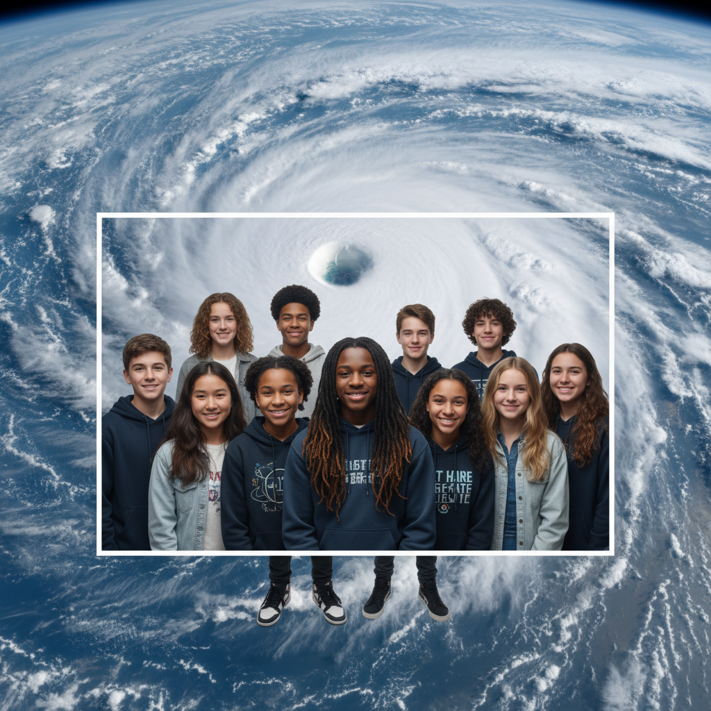
ModelIt!
Student Lesson
Why Hurricanes Are Getting Angrier
The Science Behind Supercharged Storms
NGSS: MS-ESS2-5, MS-ESS2-6
8th Grade
1/9

Slide 2
What You Will Learn Today
Learning Goals
* Explain how warm ocean water provides energy for hurricane formation
* Model how rising sea surface temperatures intensify hurricanes
* Predict how climate patterns affect hurricane strength and frequency
* Evaluate the relationship between ocean temperature and storm damage
Key Vocabulary
Sea Surface Temperature
The temperature of the ocean's surface layer, which fuels tropical storms
Rapid Intensification
When a hurricane's wind speed increases by 35+ mph in 24 hours
Storm Surge
Abnormal rise in sea level during a storm, pushed by wind and low pressure
Convection
The rising of warm air and sinking of cool air that drives weather patterns
2/9

Slide 3
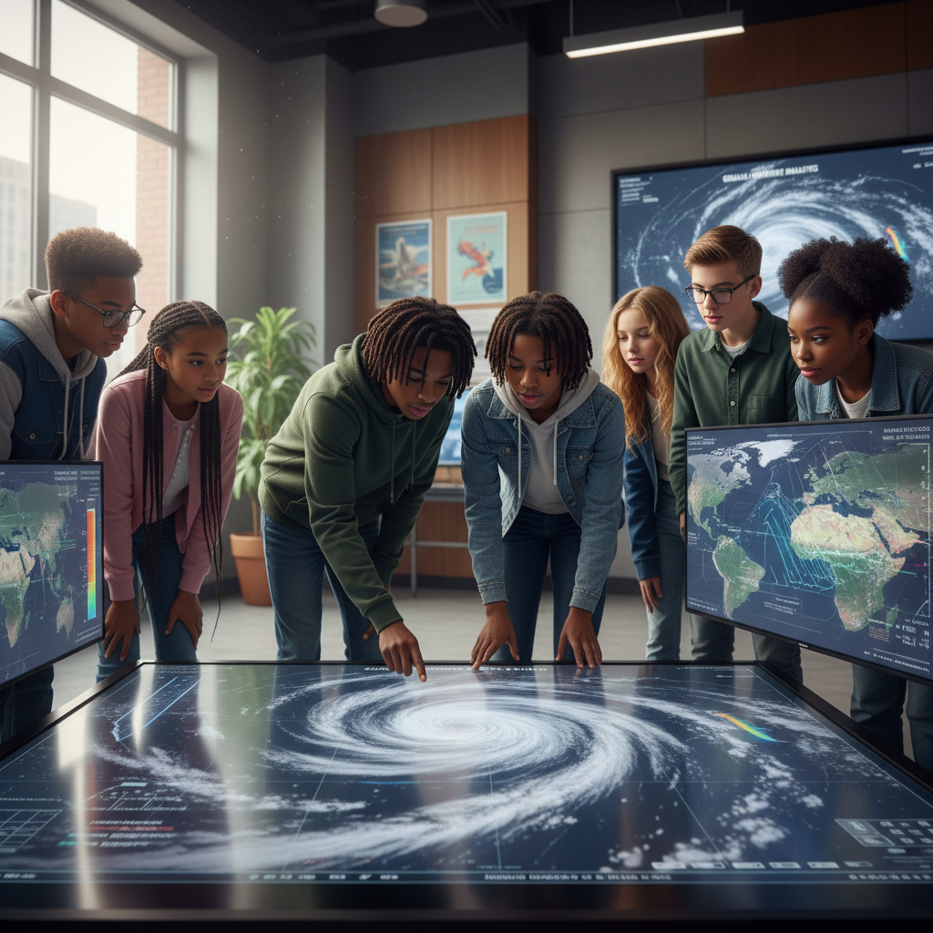
The Big Question
Why are hurricanes getting stronger and more destructive?
The Science Behind Supercharged Storms. Today we'll build a MODEL to discover the answer!
3/9

Slide 4

Today We Will Build a Model!
A model helps us understand complex systems!
1. LOCATE
Identify the COMPONENTS (parts) of the system
2. ESTABLISH
Connect them with RELATIONSHIPS (+ or -)
3. VISUALIZE
Build your model in ModelIt!
4. EVALUATE
Run SIMULATIONS to test scenarios
5. REVISE
Improve your model based on evidence
4/9

Slide 5

Activity 1: Sort the Components
Sort these components into EXTERNAL (inputs from outside) and INTERNAL (inside the system):
Your Components:
* Sea Surface Temperature
* Atmospheric Moisture
* Hurricane Wind Speed
* Storm Surge Height
Think: Which components can we control? Which happen on their own?
5/9

Slide 6
Activity 2: Connect with Arrows
Draw arrows to show HOW components affect each other:
(+) POSITIVE Relationship
When one goes UP, the other goes UP too
(-) NEGATIVE Relationship
When one goes UP, the other goes DOWN
Think About It:
When sea surface temperature increases, what do you think happens to the amount of energy available to fuel a hurricane?
6/9

Slide 7
Activity 3: Run the Simulation!
Test these scenarios in ModelIt!
Category 1 Storm
Set Sea Surface Temperature to 80°F and Moisture to moderate
Supercharged Storm
Lock Sea Surface Temperature to 90°F and observe rapid intensification
Cool Water Encounter
Start at 90°F then drop to 75°F — watch the hurricane weaken
Watch the activity graphs change!
[ModelIt Platform Screenshot - Simulation Results Graph]
7/9

Slide 8
What Did We Discover?
Our Model Showed Us:
* Hurricanes are heat engines — warm ocean water is their fuel
* Just a few degrees of extra ocean warmth dramatically increases storm intensity
* Rapid intensification is becoming more common as oceans warm
* When hurricanes hit cool water or land, they lose their energy source and weaken
Answer: Warmer ocean water provides more energy for hurricanes through evaporation and convection. As climate change heats the oceans, hurricanes have more fuel to intensify rapidly and produce devastating storm surges!
8/9

Slide 9
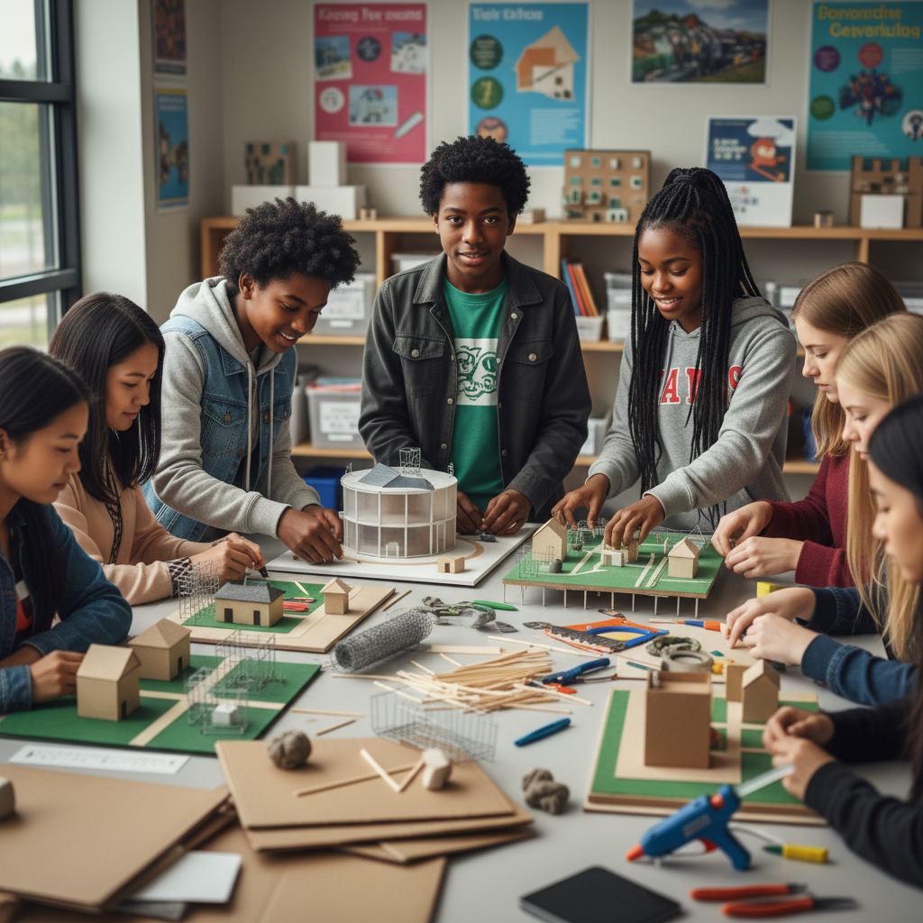
STEM Challenge: Design a Hurricane-Resilient Community
YOUR ENGINEERING MISSION
Design a coastal community plan that can withstand Category 5 hurricanes based on what your model reveals about storm behavior.
The Challenge:
A coastal city that experienced a devastating hurricane has hired your team to redesign their community to survive future storms that may be even stronger.
Think Like an Engineer:
* Based on your model, how strong could future hurricanes become?
* What is the most destructive element of a hurricane — wind or water?
* How can building design reduce hurricane damage?
REAL CAREER CONNECTION: Meteorologists and Climate Scientists study weather patterns and develop forecasting models. Hurricane Hunters fly INTO storms to collect data! They earn $70,000-$120,000/year. The skills you're using TODAY are the same ones they use on the job!
9/9

